Slide 1
LINUX / UNIX File SYSTEMS – AN ANALYSIS AND UNDERSTANDING
Shriram k Vasudevan

Slide 2
What is it?
Everything in linux/unix is file.
input is file, output is file, what not!! Everything!
In Fact, you are a file, I am a file ☺
Someone said this! “everything is a file, else, if not a file, it should be a process.
File is collection of data. File system is collection of files.
Grouping these files for easier access is referred as “file systems”
There are normal files, special files etc.
We shall see this now!!! ☺

Slide 3
File types
Directories – Holds files.
Special files - /dev can be related to input / output.
LINKS – SOFT LINK and hard link (we have seen this, remember ln –s command ?? )
Sockets – we have seen this as well! ☺
Pipes – can be named or normal pipe.
how do we find the type of the file? ☺ let’s see!!!

Slide 4
How do you find? (I shall show the demo)
→ Regular file.
d → Directory
l → SOFT AND HARDLINK (LET’S CREATE A LINK)
c → SPECIAL FILE. (GO TO /DEV., YOU SHALL FIND A LOT)
S → SOCKETS
p → NAMED PIPE (REFER MY PIPE/NAMED PIPE VIDEO)

Slide 5
MOUNT POINT!
/ → HERE IS WHERE ALL THE FILE SYSTEMS ARE MOUNTED! WELL, THIS IS THE BASE, YOU CAN SAY.
I SHALL SHOW YOU THIS NOW!

Slide 6
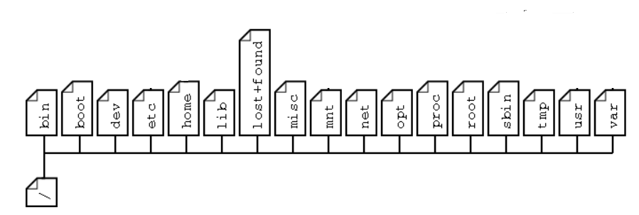
STRUCTURE
DO A CD / IN THE PROMPT
DO AN LS
YOU SHALL GET THE STRUCTURE!! ☺

Slide 7
LET US LEARN ONE AFTER ANOTHER . . . (UBUNTU SPECIFIC)
/BIN – EXECUTABLES, CREATED BY USERS, COMMANDS FOR USERS, SYS ADMIN STUFF. (YOU CAN CREATE YOUR OWN COMMAND, IT WILL BE ACTIVE ONLY WHEN YOU HAVE IT HERE!)
/BOOT – BOOT FILES (VMLINUZ IS WELL KNOWN)
/DEV – DEVICE DRIVER FILES (THIS MAKES YOUR DEVICES RUN, BUDDY)
/ETC – ALL CONFIGURATION FILES (REMEMBER CONTROL PANEL??)
/HOME – HOME FOR ALL THE USERS (YOUR HOUSE, USER)
/LIB – Library files (for all the users and programs)
/LOST and FOUND – FILES at failure shall be stored here.
/mnt – standard mount point. Cd rom or usb or a file system gets mounted here
/OPT – will have all third party software
/proc – will have all details of the process. Realtime update happens here.
/ROOT – Root user’s home here.
/SBIN – SPECIFIC FOR SYSTEM ADMIN and SYSTEM
/tmp – only for temp purpose. No storage possible. Reboot wipes of everything!
/USR – FILES, Library stuff. (Including few header files)
/VAR - log files, mail queue, print spooler etc.

Slide 8
THANKS
Shriram k vasudevan

